Slide 1
OPERATION & METRIC ANALYSIS
Project 3 – Done by B.Havilah

Slide 2
CONTENTS
Here’s what you’ll find in this PPT :
Project Description
Approach
Tech-stack used
Insights
Results
Drive link

Slide 3
PROJECT DESCRIPTION
The Operation Analytics and Investigating Metric Spike
project aims to enhance organizational decision-making and efficiency by leveraging advanced SQL skills to analyze key operational metrics. The goal is to uncover insights, trends, and anomalies within the provided datasets, facilitating informed decision-making across various departments.

Slide 4
OVERVIEW
The project is divided into two case studies, each focusing on a different set of tables and metrics. Case Study 1 involves analyzing job-related data, emphasizing aspects like throughput, language distribution, and duplicate detection. Case Study 2 delves into user engagement, growth, retention, device-specific engagement, and email interaction

Slide 5
CASE STUDY 1 -TABLE
JOB DATA
job_id: Unique identifier of jobs
actor_id : Unique identifier of actor
event: The type of event (decision/skip/transfer).
language: The Language of the content
time_spent: Time spent to review the job in seconds.
org: The Organization of the actor
ds: The date in the format yyyy/mm/dd

Slide 6
CASE STUDY 2 -TABLES
USERS
EVENTS
EMAIL EVENTS
Contains one row per user, with descriptive information about that user’s account.
Contains one row per event, where an event is an action that a user has taken (e.g., login, messaging, search).
Contains events specific to the sending of emails.

Slide 7
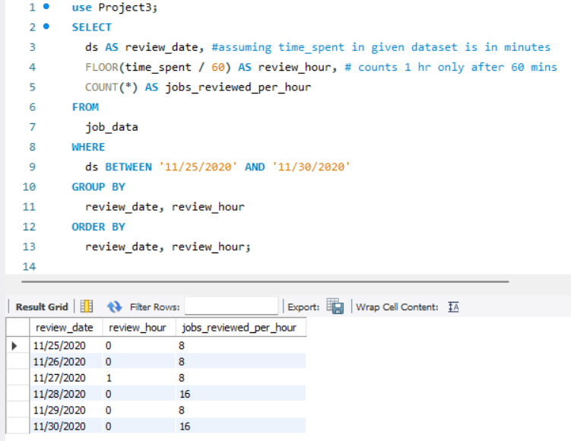
APPROACH
Case Study 1: Job Data Analysis
Objective 1: Jobs Reviewed Over Time
Task: Calculate the number of jobs reviewed per hour for each day in November 2020.
This SQL approach efficiently calculates the number of jobs reviewed per hour for each day in November 2020. It utilizes the SELECT statement to extract the date, hour, and count of job reviews based on the created_at timestamp from the specified table (job_reviews). The WHERE clause filters the data to include only entries from November 2020.
The GROUP BY clause groups the results by date and hour. Finally, the ORDER BY clause arranges the results in ascending order based on date and hour

Slide 8
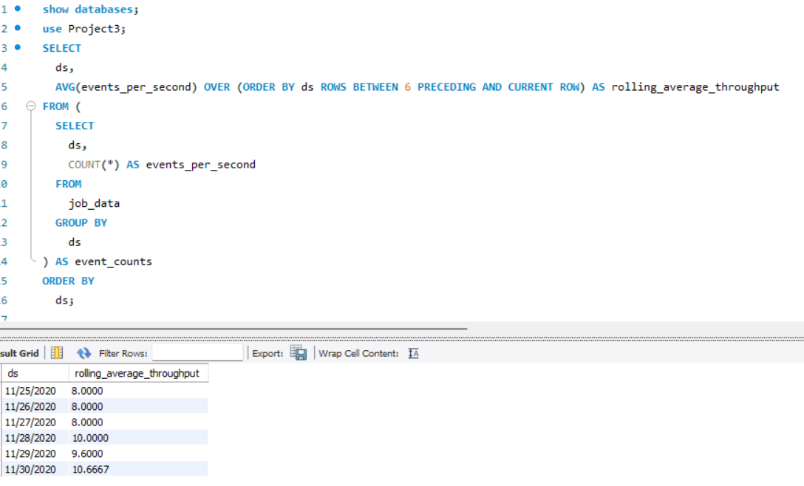
APPROACH
Objective 2: Throughput Analysis
Task: Calculate the 7-day rolling average of throughput (number of events per second). Also, explain the preference for daily metric or 7-day rolling average.
The SQL query calculates the 7-day rolling average throughput for events recorded in the "job_data" table. It utilizes a subquery to count events per second for each date and then employs the AVG() window function in the main query to compute the rolling average over a 7-day window.
The result set includes columns for the date (ds) and the corresponding rolling average throughput.

Slide 9
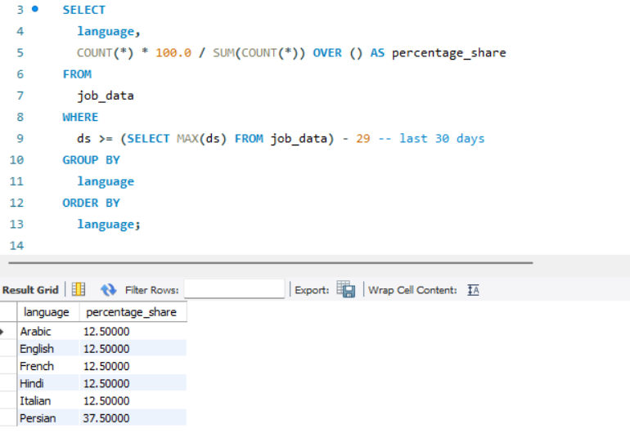
APPROACH
Objective 3: Language Share Analysis
Task: Calculate the percentage share of each language in the last 30 days.
This SQL query calculates the percentage share of each language in the last 30 days from the "job_data" table. It utilizes a WHERE clause to filter data for the specified timeframe, then employs COUNT() and SUM() functions to determine the percentage share for each language.
The result set includes language categories along with their corresponding percentage shares, ordered alphabetically.

Slide 10
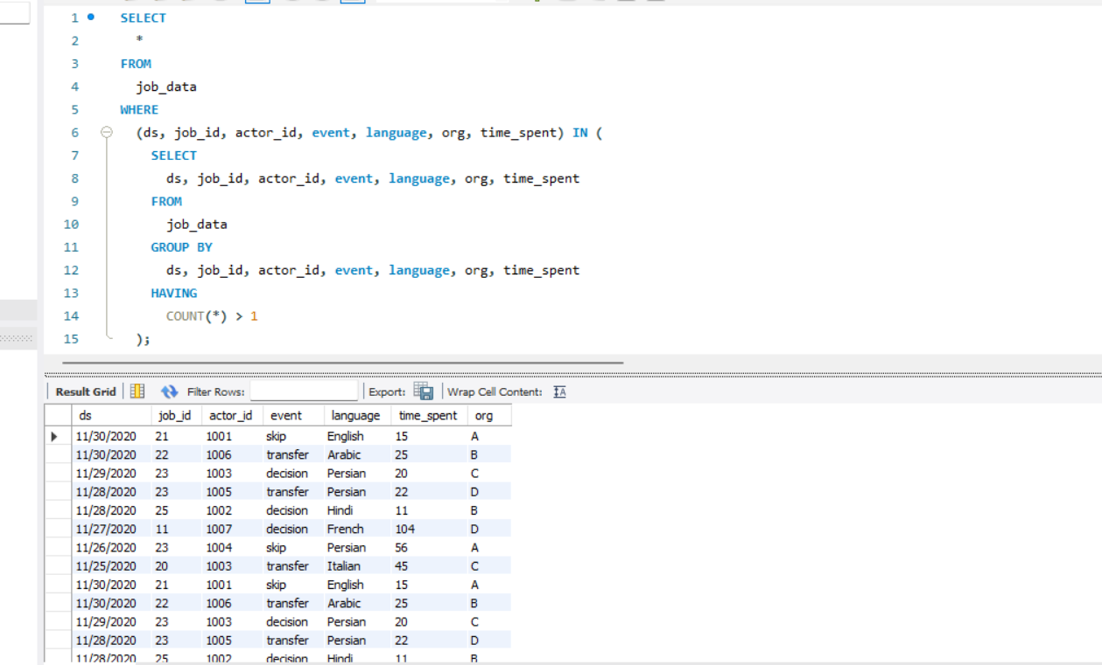
APPROACH
Objective 4: Duplicate Rows Detection
Task: Identify duplicate rows in the data.
This SQL query retrieves all columns from the "job_data" table where specific combinations of columns (ds, job_id, actor_id, event, language, org, time_spent) have duplicate occurrences. The query employs a subquery that groups the data by these specified columns, then filters for groups where the count is greater than one using the HAVING clause.
The result is a dataset containing rows with duplicate combinations of values in the specified columns, helping to identify and display instances of duplicated data in the "job_data" table.

Slide 11
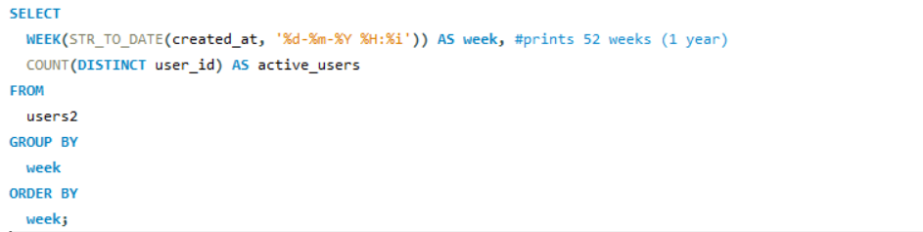
APPROACH
Case Study 2: Investigating Metric Spike
Objective 1: Weekly User Engagement
Task: Calculate the weekly user engagement.
This SQL approach efficiently calculates the number of jobs reviewed per hour for each day in November 2020. It utilizes the SELECT statement to extract the date, hour, and count of job reviews based on the created_at timestamp from the specified table (job_reviews). The WHERE clause filters the data to include only entries from November 2020.
The GROUP BY clause groups the results by date and hour. Finally, the ORDER BY clause arranges the results in ascending order based on date and hour

Slide 12
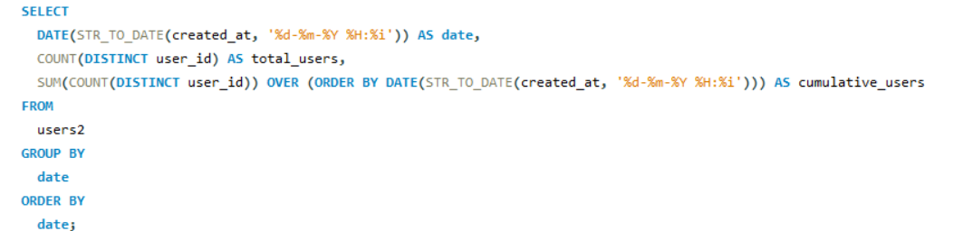
APPROACH
Objective 2: User Growth Analysis
Task: Analyze the growth of users over time for a product.
This SQL approach efficiently calculates the number of jobs reviewed per hour for each day in November 2020. It utilizes the SELECT statement to extract the date, hour, and count of job reviews based on the created_at timestamp from the specified table (job_reviews). The WHERE clause filters the data to include only entries from November 2020.
The GROUP BY clause groups the results by date and hour. Finally, the ORDER BY clause arranges the results in ascending order based on date and hour

Slide 13
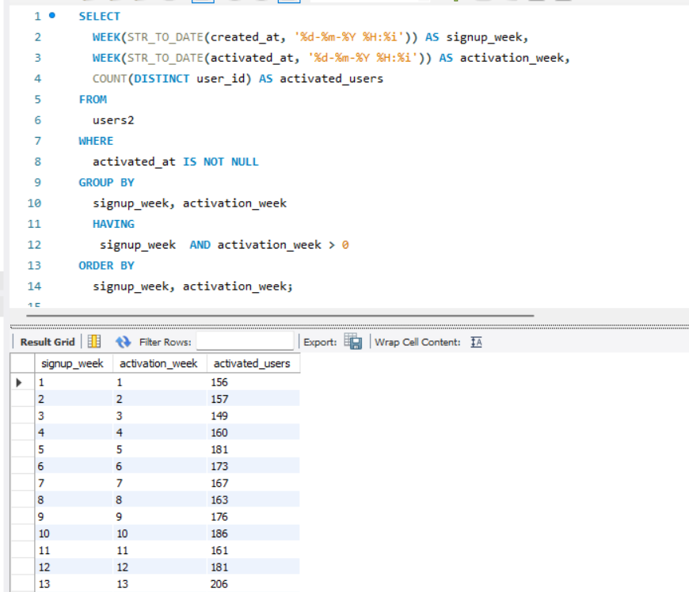
APPROACH
Objective 3: Weekly Retention Analysis
Task: Analyze the weekly retention of users based on their sign-up cohort.
This SQL approach efficiently calculates the number of jobs reviewed per hour for each day in November 2020. It utilizes the SELECT statement to extract the date, hour, and count of job reviews based on the created_at timestamp from the specified table (job_reviews). The WHERE clause filters the data to include only entries from November 2020.
The GROUP BY clause groups the results by date and hour. Finally, the ORDER BY clause arranges the results in ascending order based on date and hour

Slide 14
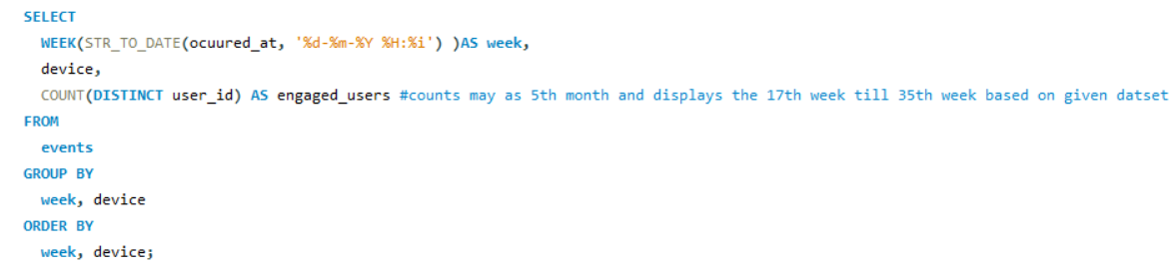
APPROACH
Objective 4: Weekly Engagement Per Device
Task: Calculate the weekly engagement per device.
This SQL approach efficiently calculates the number of jobs reviewed per hour for each day in November 2020. It utilizes the SELECT statement to extract the date, hour, and count of job reviews based on the created_at timestamp from the specified table (job_reviews). The WHERE clause filters the data to include only entries from November 2020.
The GROUP BY clause groups the results by date and hour. Finally, the ORDER BY clause arranges the results in ascending order based on date and hour

Slide 15
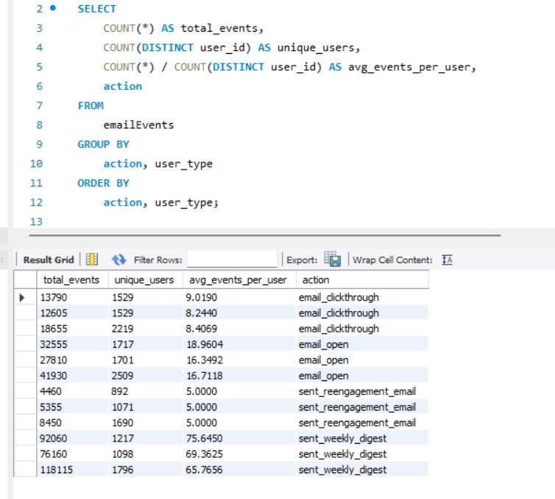
APPROACH
Objective 5: Email Engagement Analysis
Task: Analyze how users are engaging with the email service.
The SQL query examines email engagement metrics from the emailEvents table, calculating the total events, unique users, and average events per user for different email actions. The GROUP BY clause facilitates a granular breakdown by email action and user type, providing valuable insights into user interactions.
The query is ordered by action and user type for clarity, offering a succinct analysis of email engagement patterns. Adjustments can be made to tailor the query to specific requirements or include additional metrics.

Slide 16
TECH-STACK USED
MYSQL WORKBENCHH 8.0 CE,
SQL SERVER MANAGEMENT STUDIO

Slide 17
INSIGHTS
CASE STUDY -1
1) Review hour
Insights & Interpretation: This analysis helps in understanding the temporal distribution of job reviews. Insights gained can be used to identify peak hours and optimize resource allocation accordingly.
Output:
Counts only 60 mins as a hour and presents from the dates given 25-30th of the November 2020

Slide 18
INSIGHTS
2) Throughput Analysis
Insights & Interpretation: Throughput analysis is crucial for performance evaluation. The 7-day rolling average provides a smoothed trend, minimizing the impact of daily fluctuations. The choice between daily and rolling average depends on the need for granularity or a more stable trend overview.
Output:

Slide 19
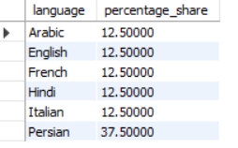
INSIGHTS
3) Language Share Analysis
Insights & Interpretation: Understanding the language distribution over time is vital for content optimization and targeting specific user groups. Insights gained here can inform localization efforts and content strategy.
Output:

Slide 20
INSIGHTS
4) Duplicate Rows Detection
Insights & Interpretation: Identifying duplicates is essential for data quality assurance. It ensures that the analysis is based on accurate information, preventing skewed results due to redundant data.
Output:

Slide 21
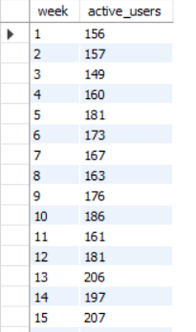
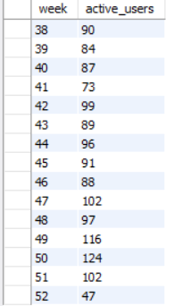
INSIGHTS
CASE STUDY -2
Weekly User Engagement
Insights & Interpretation: Weekly user engagement provides a snapshot of user activity patterns. Identifying trends can guide marketing efforts and feature development to enhance user interaction.
Output:
It prints from week 1 to 52 .Here, I showed first and last rows of the output.

Slide 22
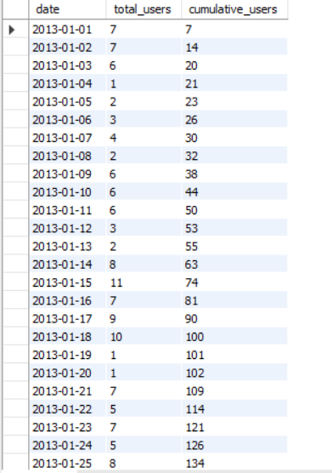
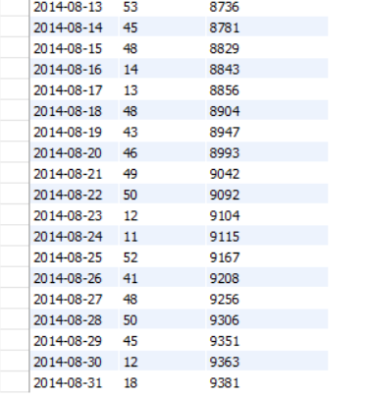
INSIGHTS
2) User Growth Analysis
Insights & Interpretation: Understanding user growth is fundamental for assessing the product's market penetration and popularity. Insights here can drive strategic decisions related to marketing and scalability.
Output:
Here, It prints from 2013-01-01 to 2014-08- 31 , showing total cumulative users as 9,381

Slide 23
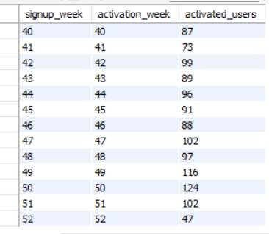
INSIGHTS
3) Weekly Retention Analysis
Insights & Interpretation: Retention analysis aids in understanding user loyalty. Recognizing when users tend to drop off post-signup allows for targeted efforts to improve user experience and satisfaction.
Output:
Prints from week 1 to 52, Here I showed few of first and last rows

Slide 24
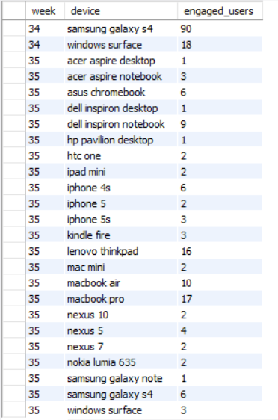
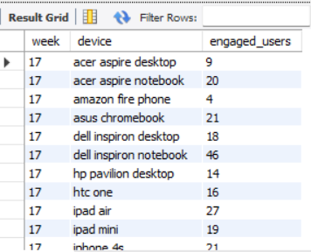
INSIGHTS
4) Weekly Engagement Per Device
Insights & Interpretation: Analyzing engagement across devices helps tailor the user experience. Insights gained can guide development efforts to optimize features for specific devices, improving overall user satisfaction.
Output:
Prints from week 17 to 35, Here I showed few of first and last rows.

Slide 25
INSIGHTS
5) Email Engagement Analysis
Insights & Interpretation: Understanding email engagement is crucial for effective communication. Insights here can inform strategies for content creation, segmentation, and personalization to enhance user interaction.

Slide 26
RESULTS
Potential Achievements and Contributions:
Data-Driven Insights:
Deriving meaningful insights from the analysis of operational metrics.
Understanding patterns, trends, and anomalies in key performance indicators.
Operational Optimization:
Identifying areas for improvement in the company's operations.
Recommending strategies to enhance resource allocation, user engagement, and overall efficiency.
Decision-Making Support:
Providing valuable information for decision-makers across departments.
Enabling data-driven decision-making for strategic planning
My Understandings & Learnings:
Advanced SQL Skills: Improved proficiency in utilizing advanced SQL queries for diverse analytical tasks.
Operational Analytics: Enhanced understanding of operational analytics methodologies and their application in real-world scenarios.
Practical Application: Gained hands-on experience in applying analytical techniques to address business challenges, contributing to a practical understanding of data analysis in operational contexts.

Slide 27
DRIVE LINK
Operation Analytics and Investigating Metric Spike

